Slide 1
From First Cloud AI Journey
to AWS Partner
12/06/2026
Danh Hoàng Hiếu Nghị
AI Engineer – AWS Community Builder – AWS Student Builder Group Leader

Slide 2
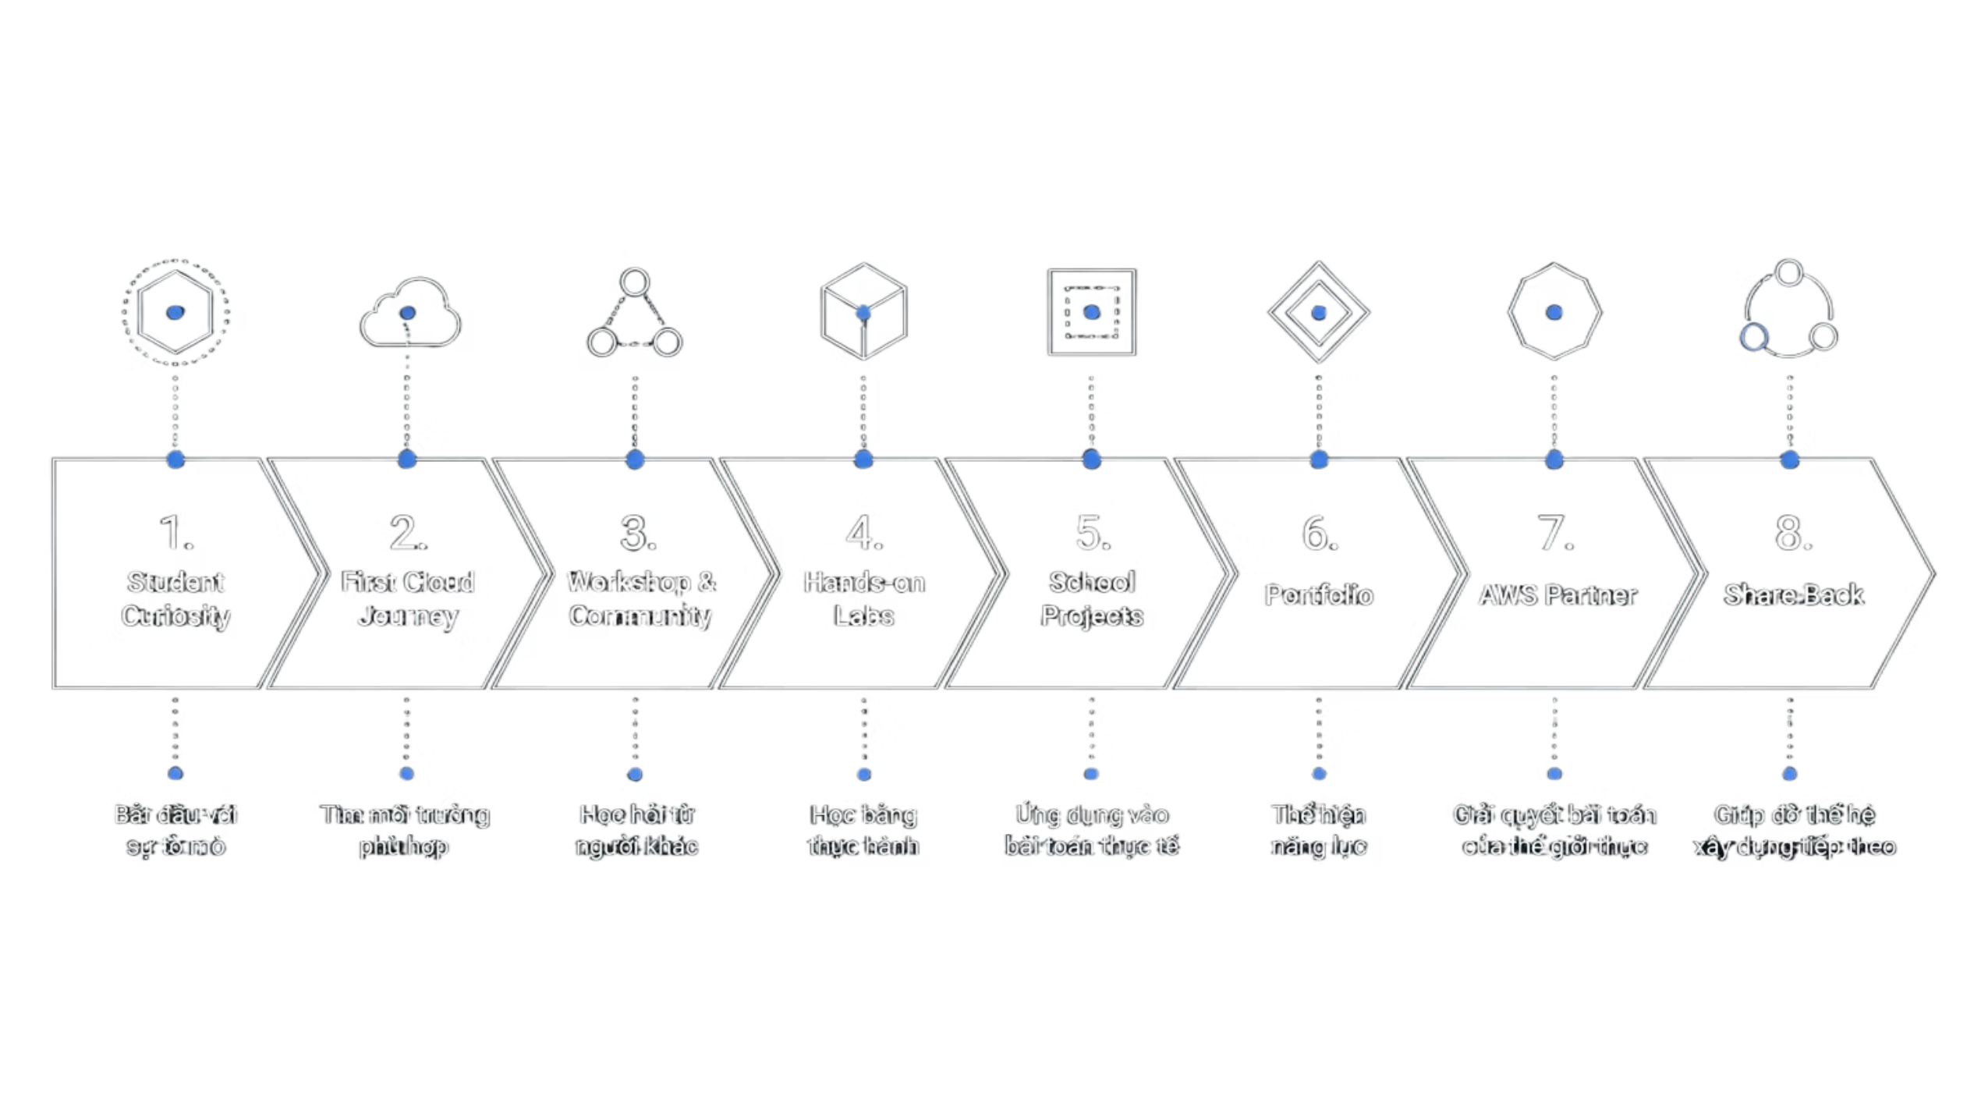

Slide 3
First Cloud AI Journey Program
Ex First Cloud Journey Program

Slide 4
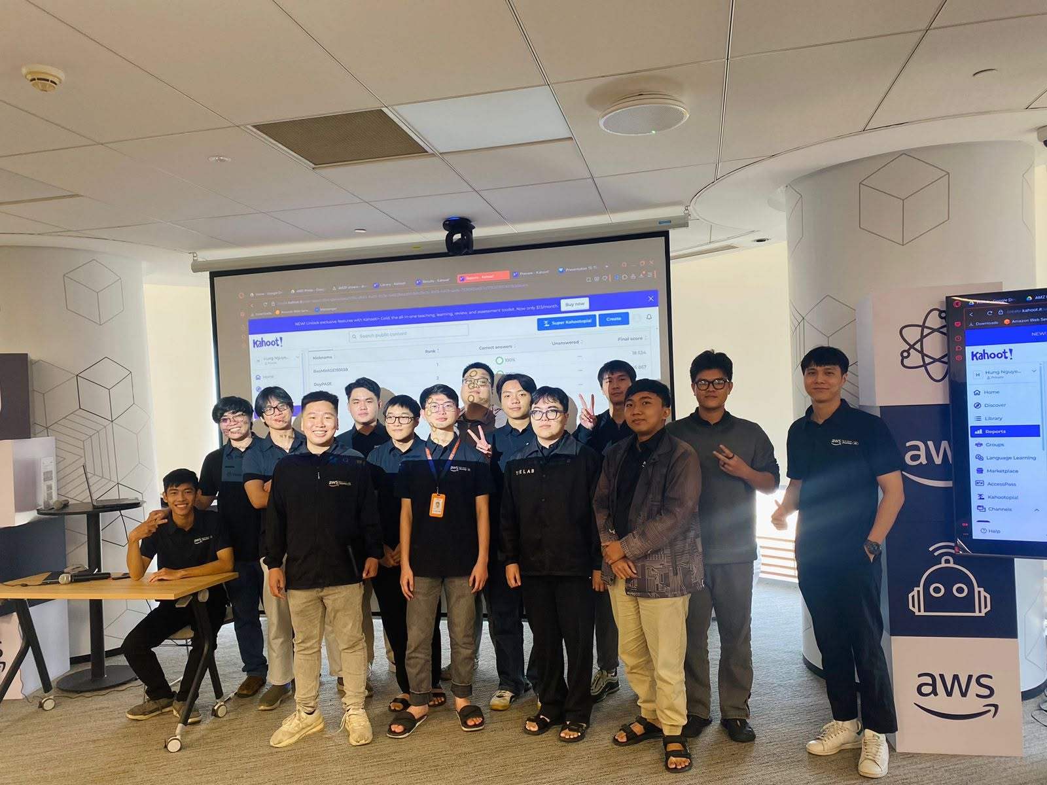
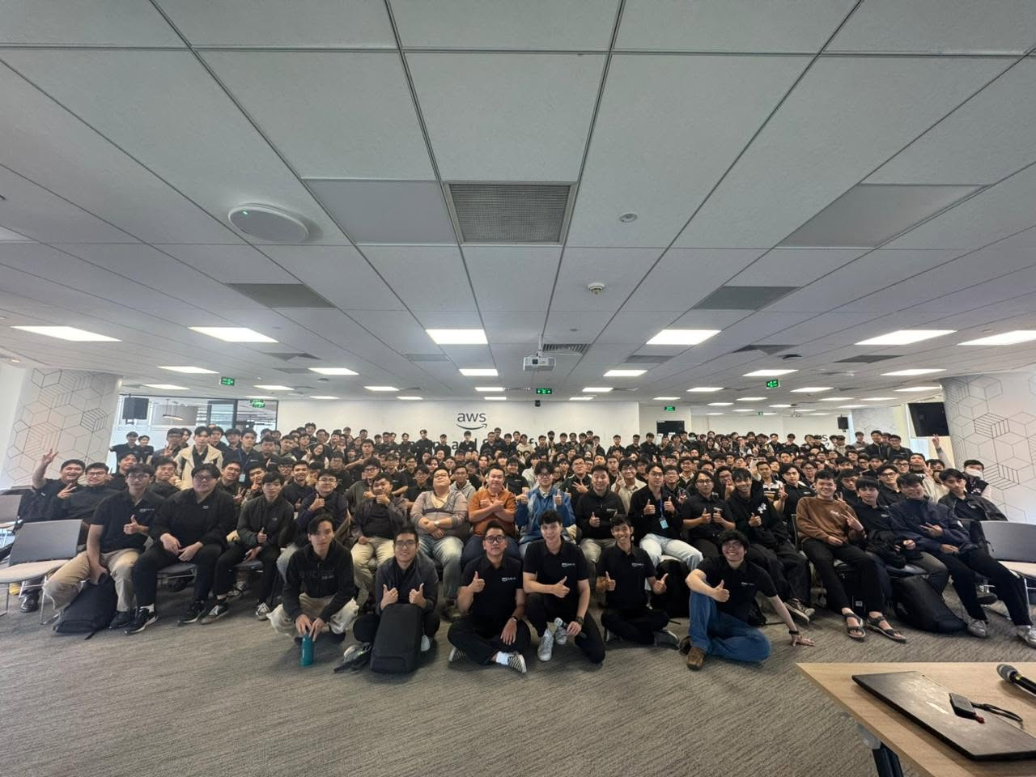
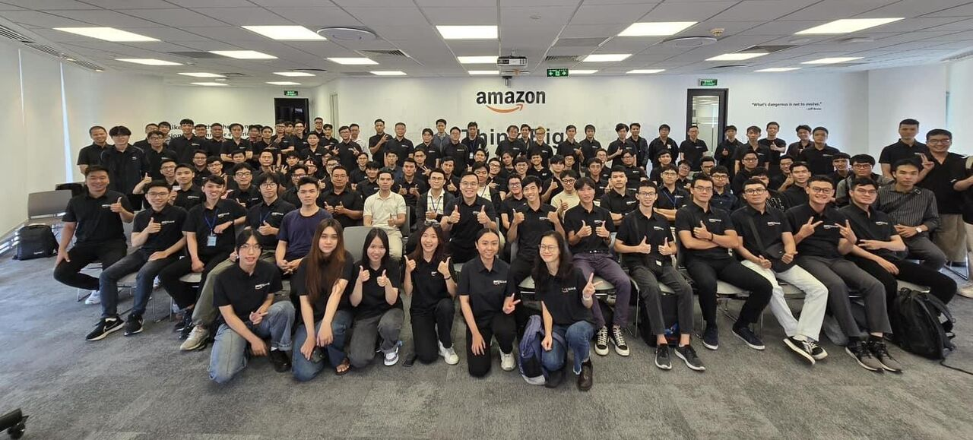

Slide 5
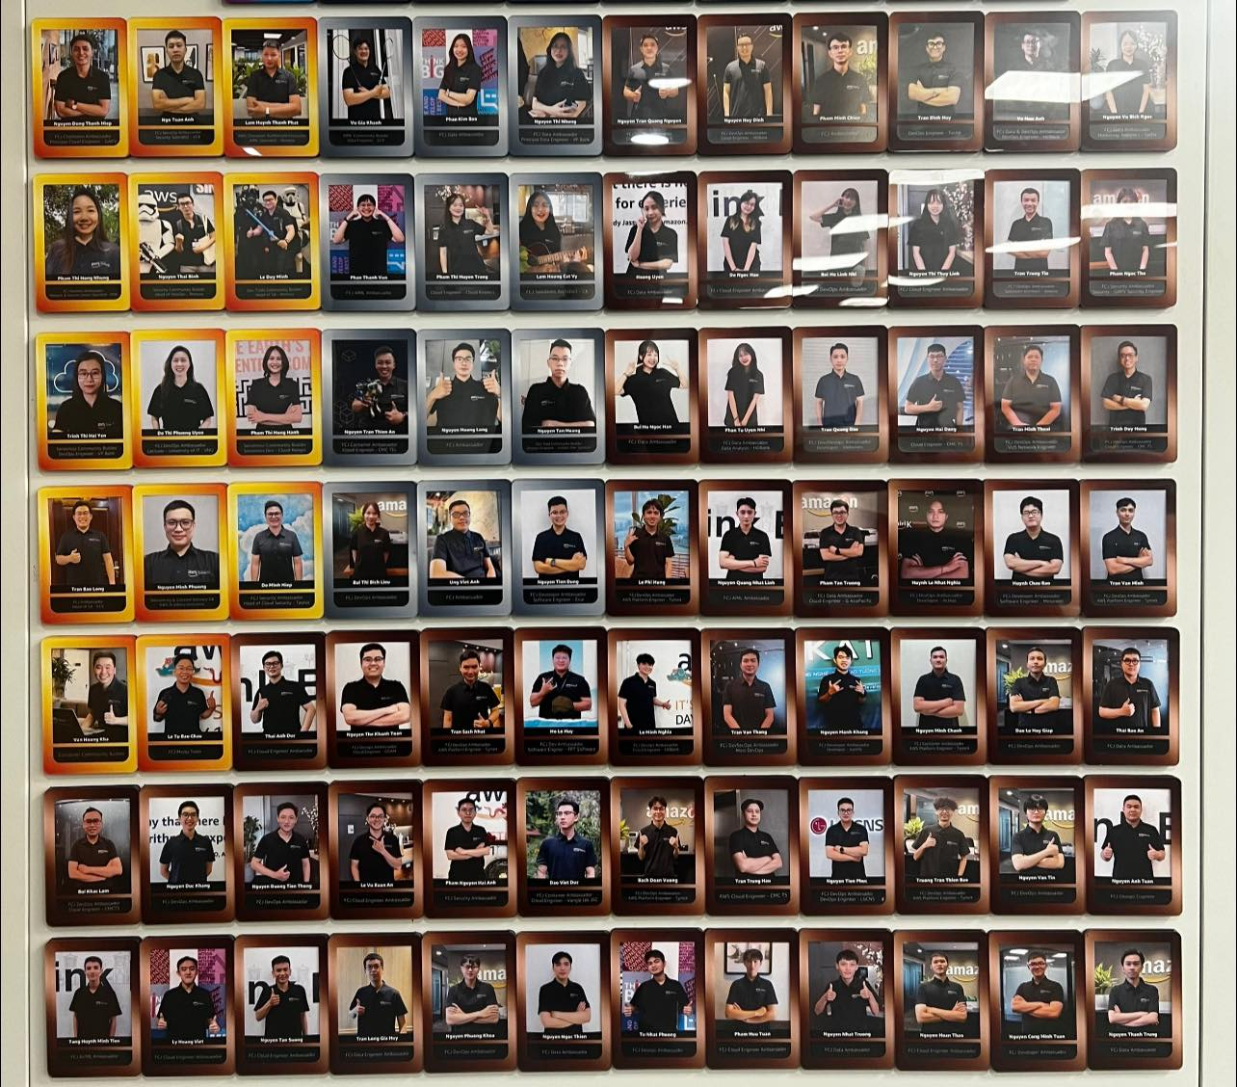
Getting the job is just a beginning…
Solutions Architect
Head of Solutions Architect
DevOps Engineer
Platform Engineer
Software Engineer
Write your own history !

Slide 6
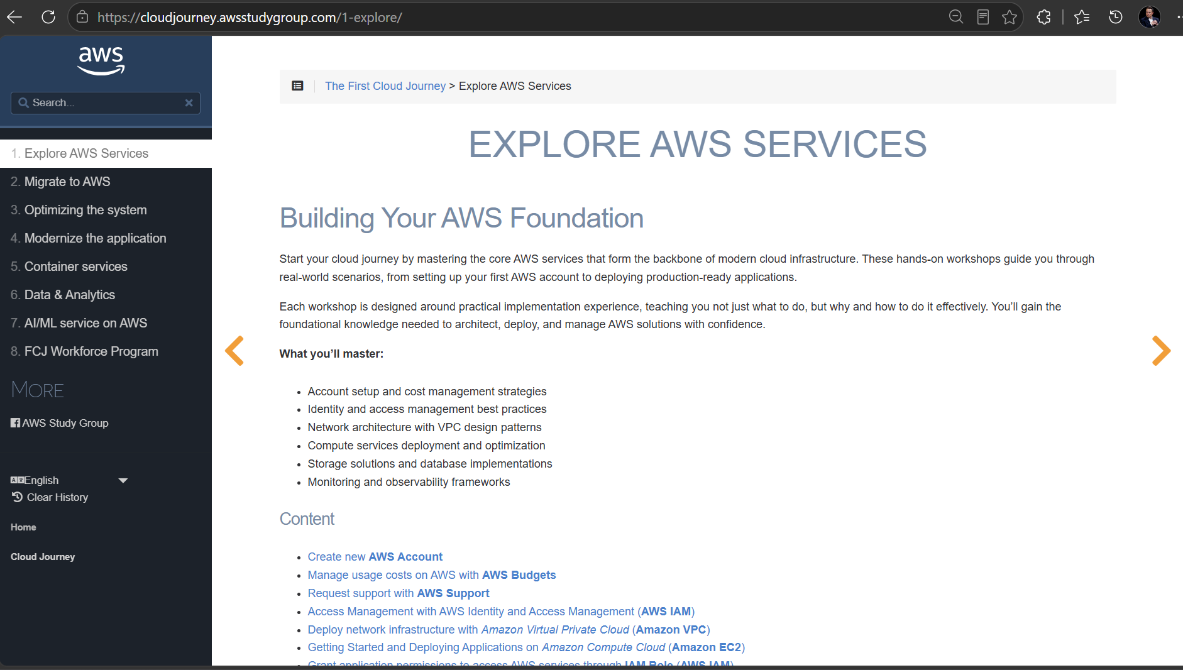

Slide 7
AWS Student Builder Group Program
Ex AWS Cloud Clubs Program

Slide 8
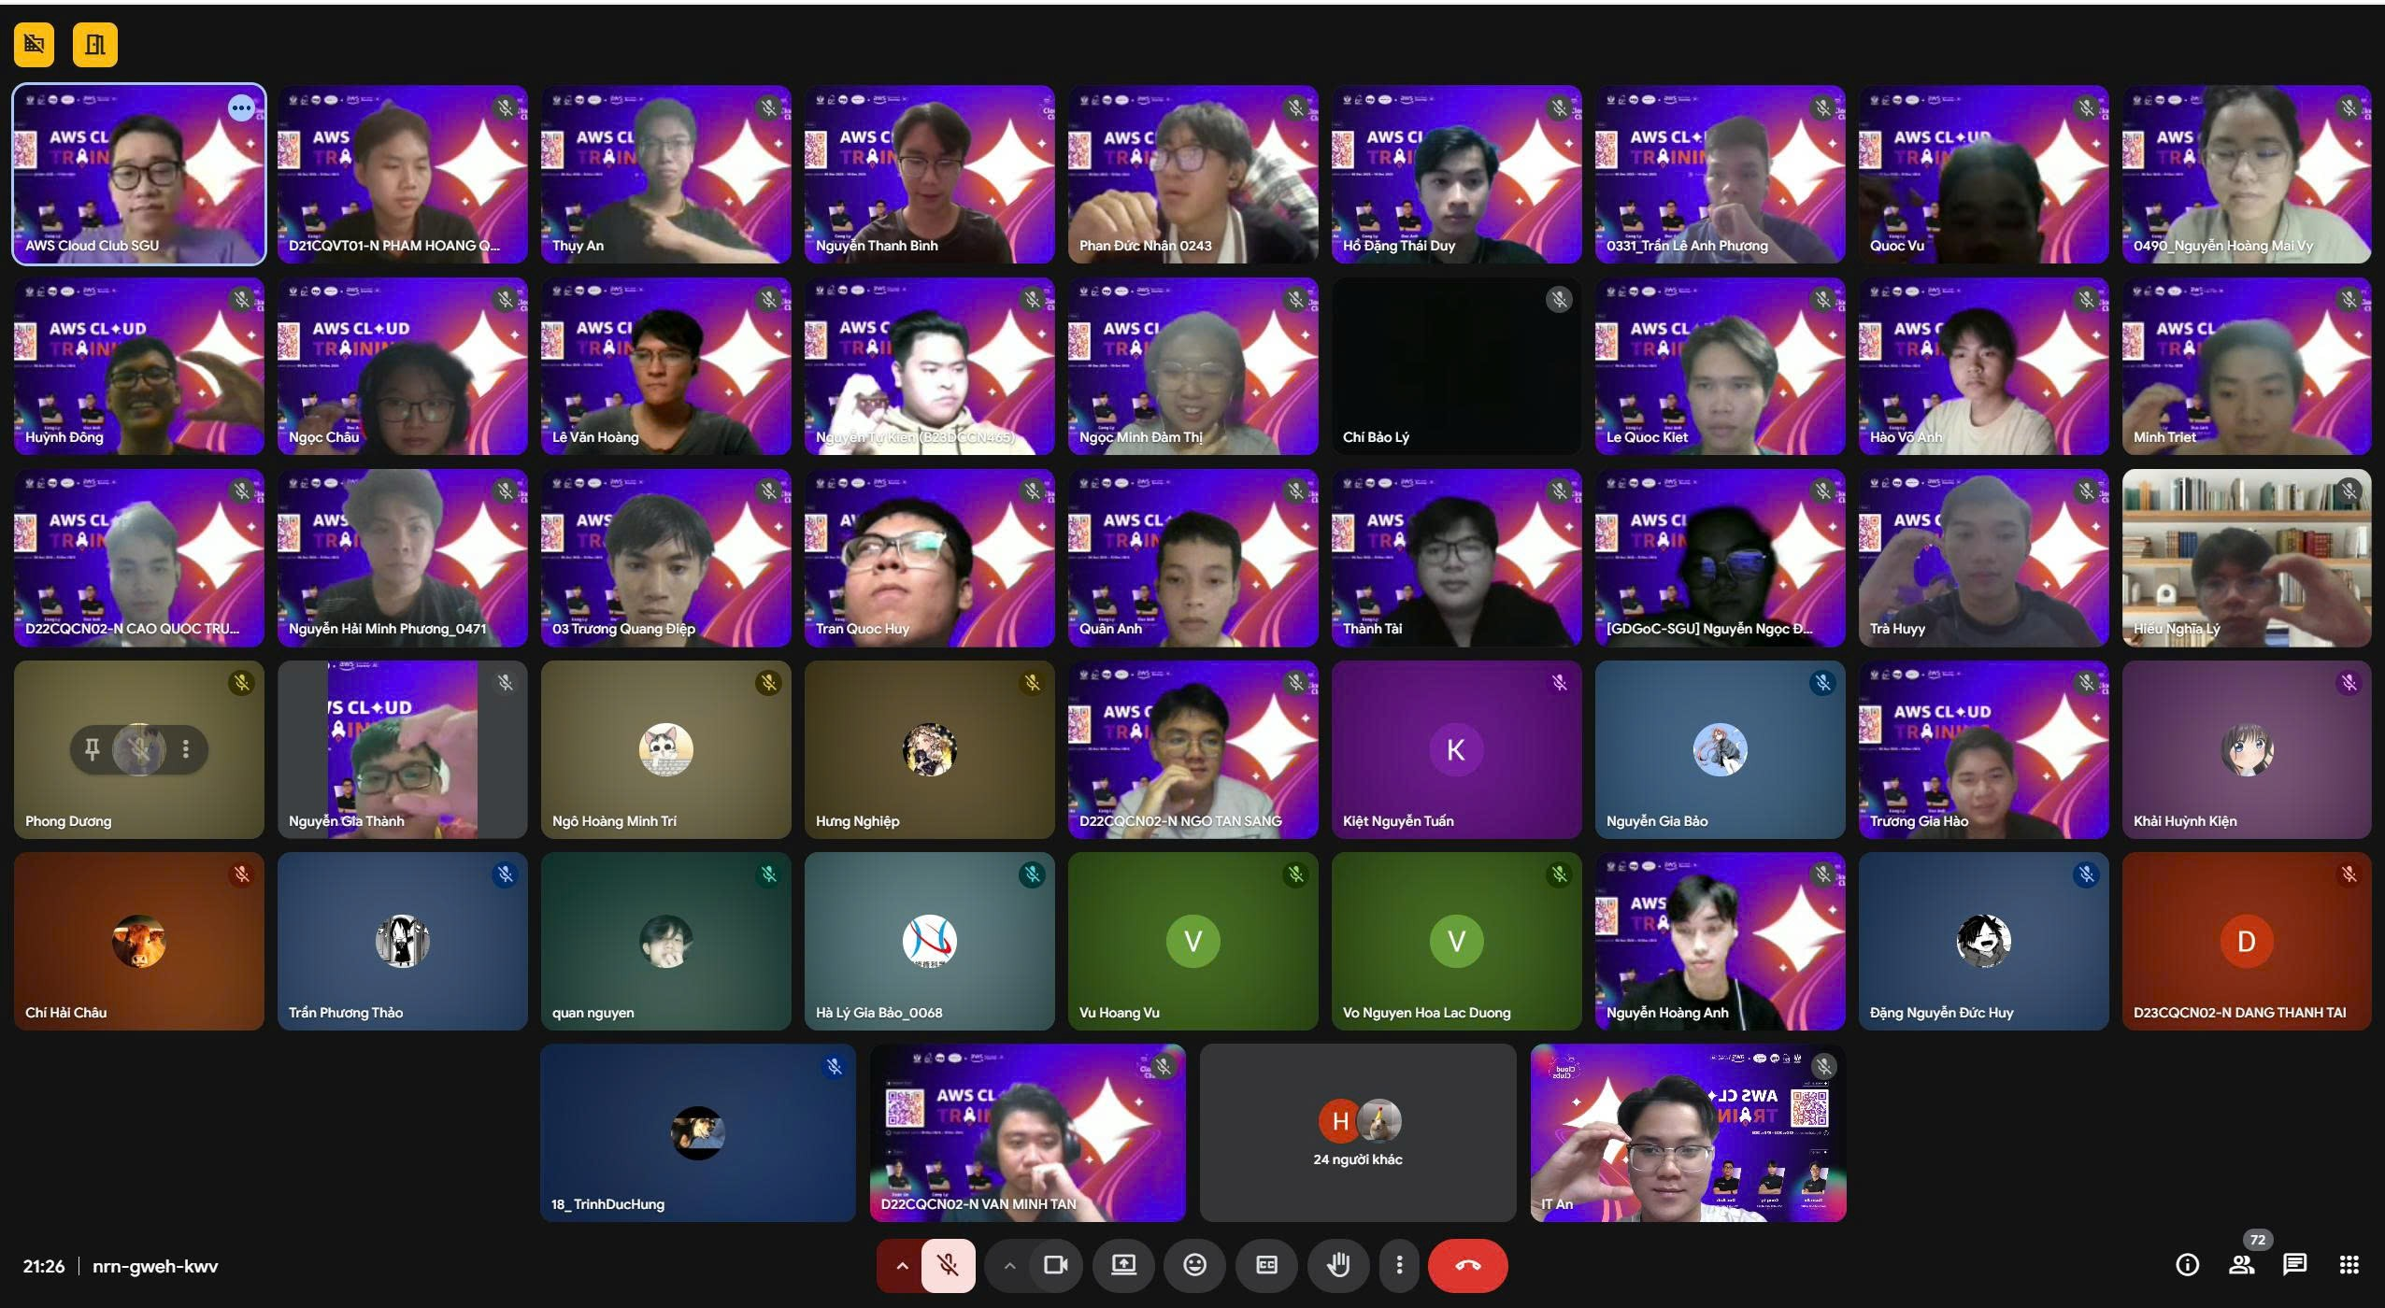
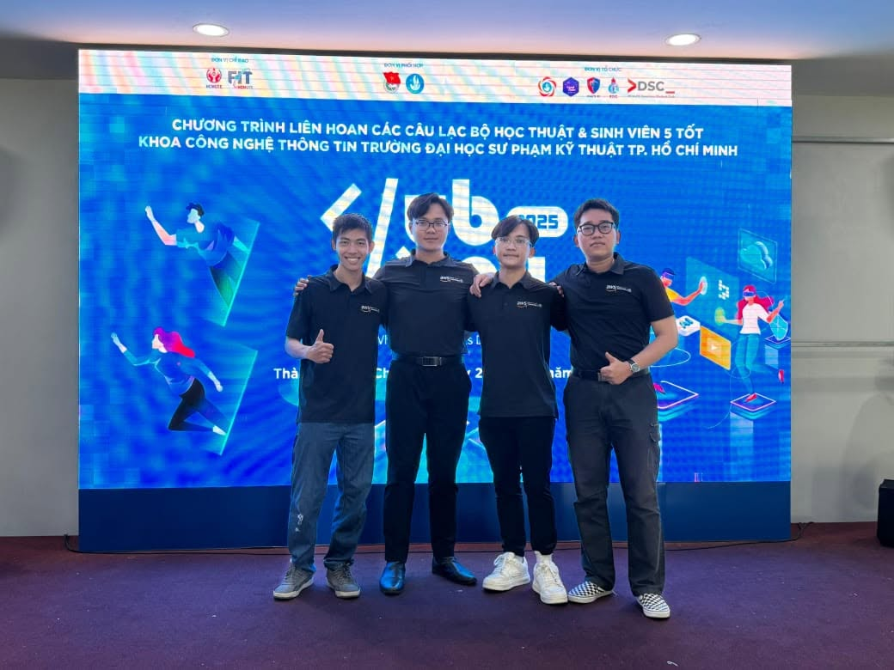
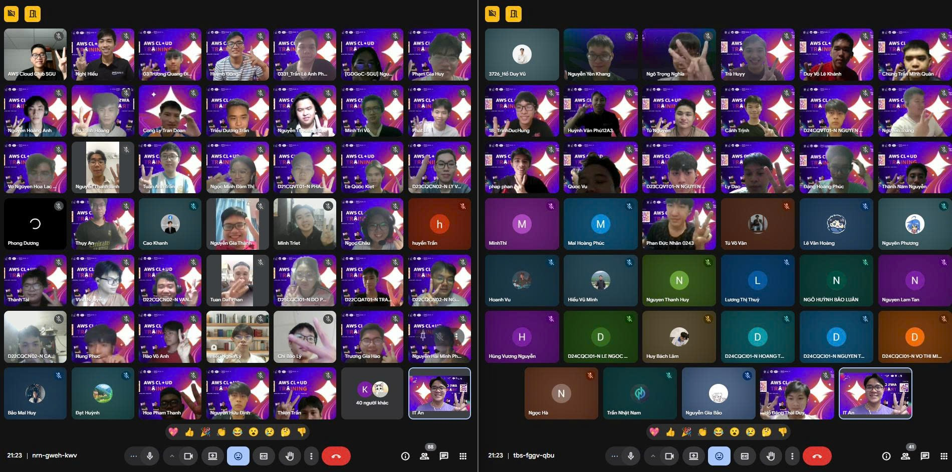
builder.aws.com/community/student-builder-groups

Slide 9
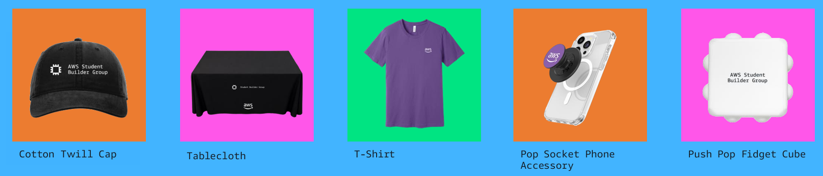

Slide 10
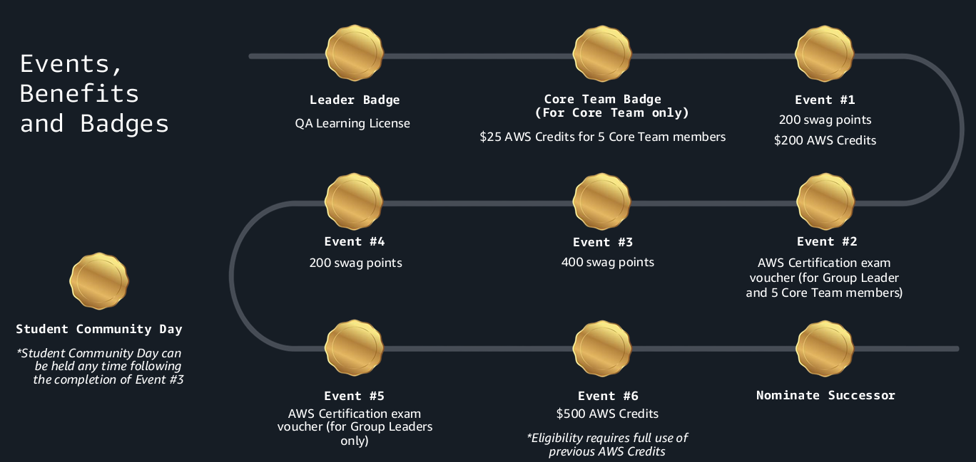

Slide 11
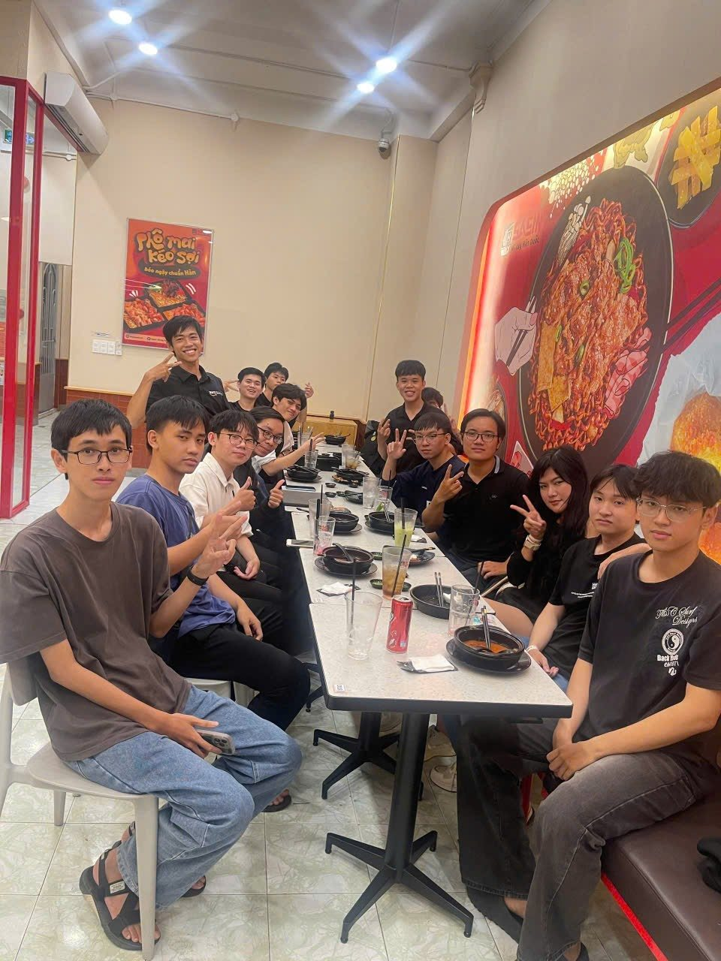
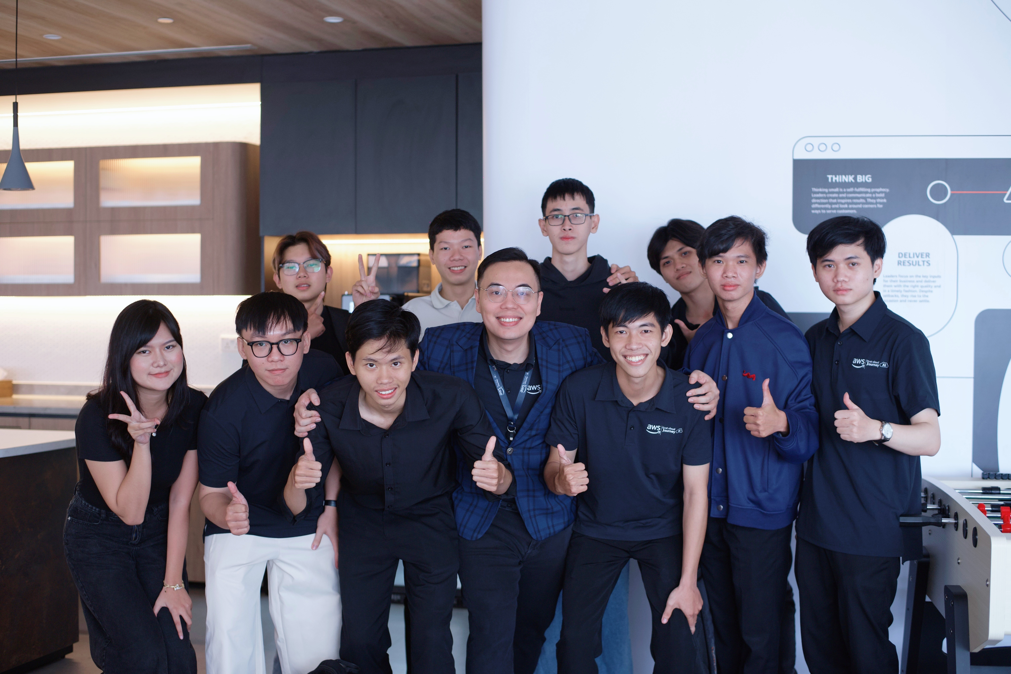
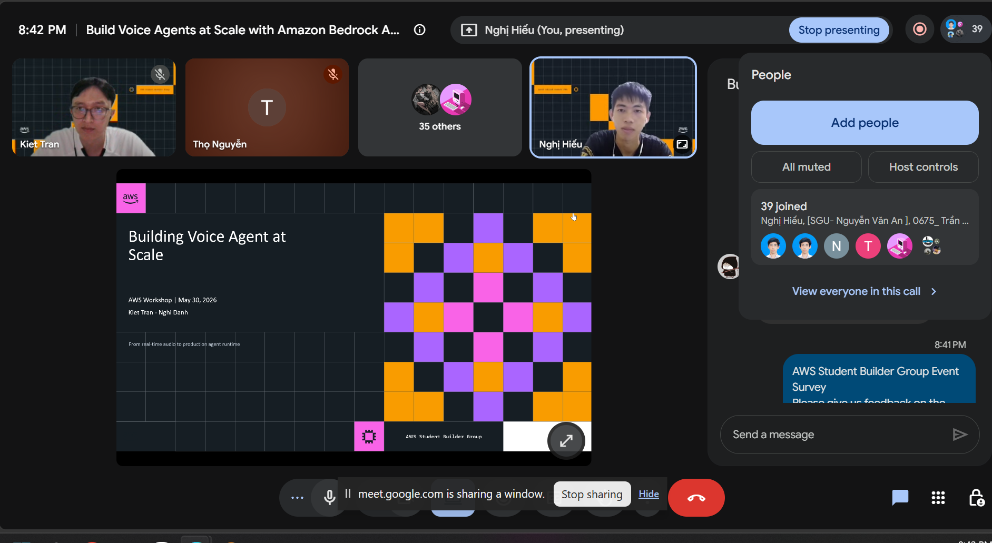
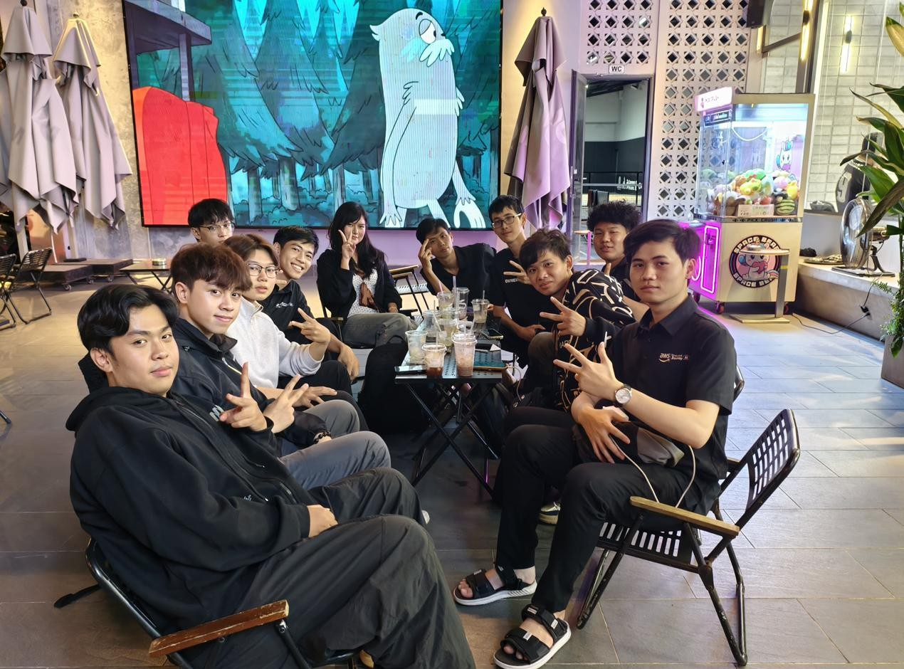

Slide 12

AWS Community Builder Program

Slide 13
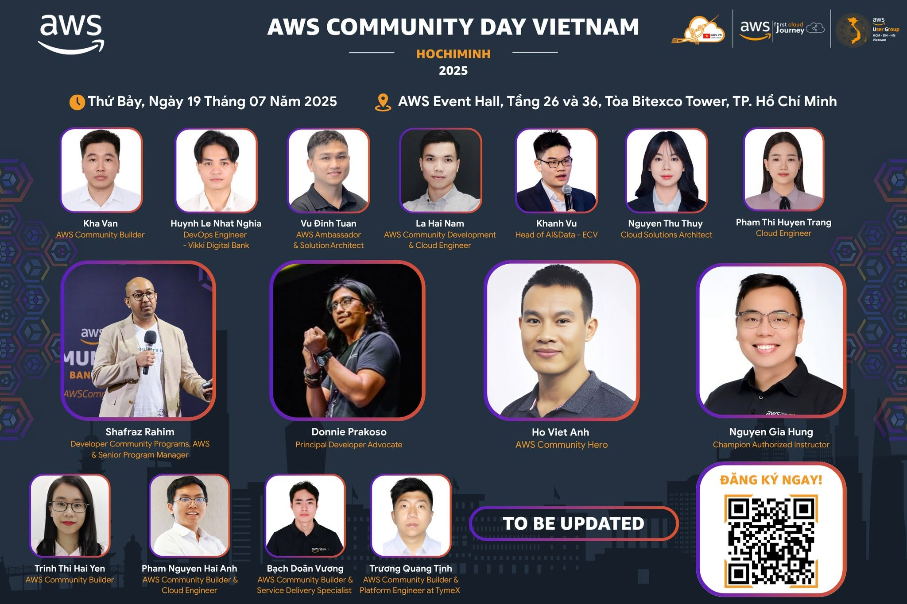
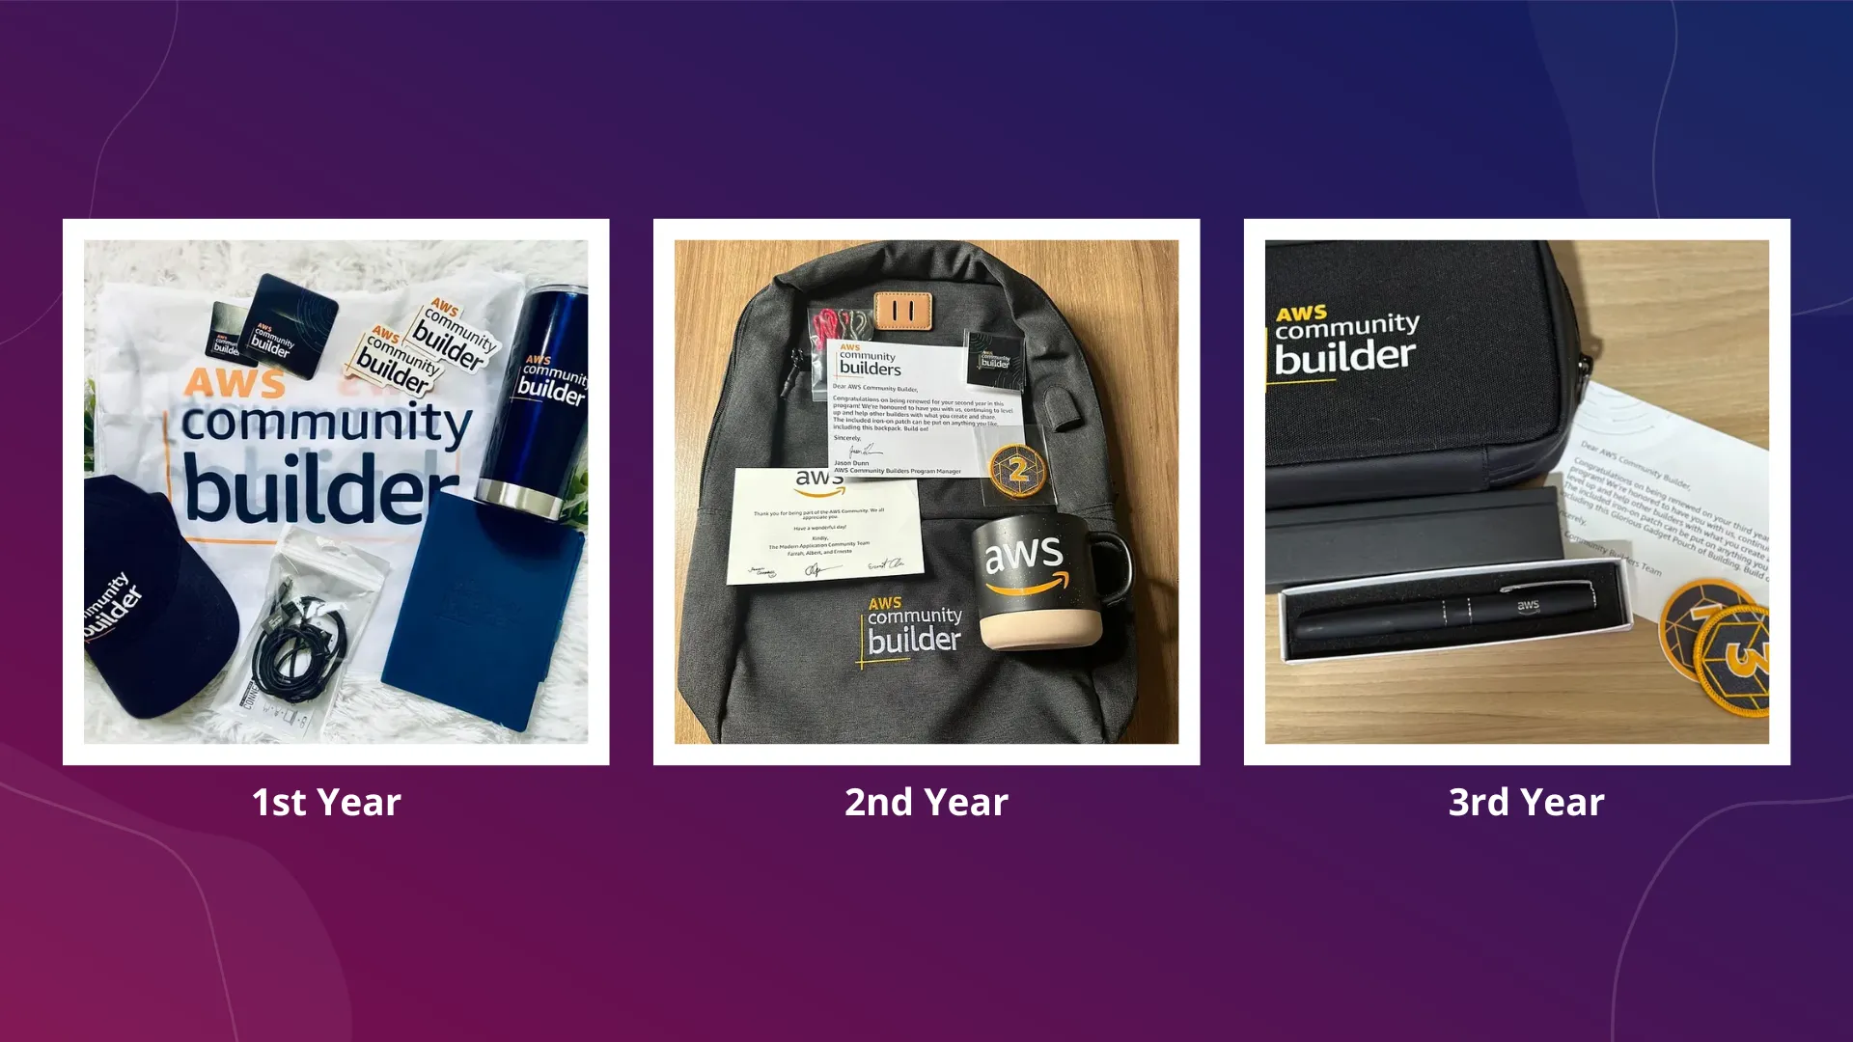

Slide 14
AWS Partners

Slide 15
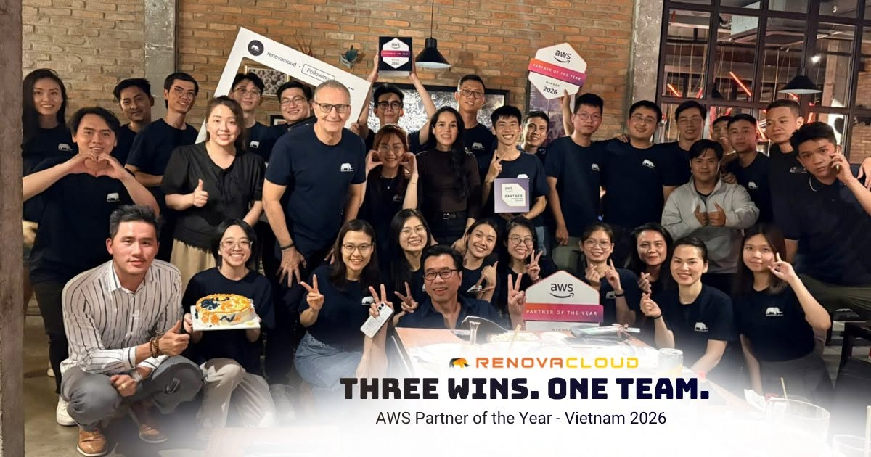

Slide 17
Linkedin Connection
Linkedin.com/in/hieunghi/

